Slide 1
Rossman Project
Team Awesome Incredible:
Avinash Kamath, Kyle bartsch, prateek bhadsavle

Slide 2
About the dataset

Slide 3
Rossman Dataset
Sales
Stores

Slide 4
Data Cleansing

Slide 5
Data Cleansing

Slide 6
Missing Values
Stores Dataset:
Competition Distance – only for 3 stores (81,862,957)
Competition Open Since Month / Competition Open Since Year – 317 stores
Affects Competition Open Date – if values are NA,
Promo2 Since Week / Promo2 Since Year – 486 Stores
Affects Promo2 – Appears if Promo2 = 0, it never was offered and the date values are truly unknown.

Slide 7
Imputing Missing Values
Competition Distance – May not be worth the time (3 stores)
No single other attribute appears to be predictive of Competition Distance
Perhaps we can use K-means clustering to find similar stores?
Then impute based on an average of Competition Distance of similar stores?
Competition Open Date – Highly missing, but may be predictive
No other attributes seem to be predictive of Open Date
Perhaps we can use K-means clustering to find similar stores?
Promo2 Start Date – No need
When Promo2 = 0, the promo was not offered

Slide 8
Feature Engineering

Slide 9
Features We Engineered:

Slide 10
Exploratory Data Analysis

Slide 11
Univariate EDA

Slide 12
Bivariate EDA

Slide 13
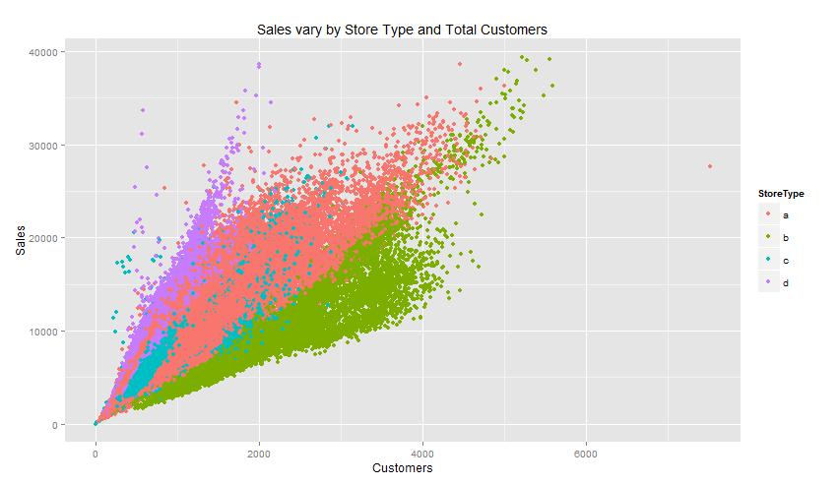
Sales vs. Total Customers/Store Type

Slide 14
Plans for data modeling

Slide 15
Modeling Techniques To Consider:
Traditional Linear Regression
Start with stepwise selection for dimension reduction
Determine optimal # of dimensions based on AIC
Decision Trees
Start will all dimensions
Prune tree to find most parsimonious model
Bagging
Random Forest
Boosting

Slide 16
General Modeling Parameters
Models will be optimized using 5-Fold Cross Validation and the Caret Package
Regression will use lowest 5-Fold RMSE

